Slide 1


Fan Engagement NBA Tweets
Jiho Song
Notes:
Hi, my name is Jiho Song
In advance, I want to say thank you for listening my analysis.
I have analyzed a fan engagement of NBA tweets.

Slide 2
Agenda
01
Intro
- Purpose
- Dataset
02
Analysis
Competitor
Team
Division
Player
Monthly Keywords
03
Conclusion
Notes:
Today’s presentation consists of three parts
I am going to share the purpose and dataset first, and then mention specific subject such as comparing with competitor, which team, division and players did frequently mentioned on Twitter.
Also, I am going to share keywords per month.

Slide 3
1. Intro – Purpose
Situation
Fan tweets characteristic
Brand Reputation
Target Customer
What is the best option to appeal to target customers?
1) Team
2) Division
3) Player
4) Key word
Notes:
The purpose of the presentation is to help us to understand what is happening on Twitter and check our brand reputation.
Based on the understanding, I am going to explain the twitter data in detail to find the best way to appeal to our target customers.
So, I want to discuss which team, division, player, and keywords would help us improve our marketing result.

Slide 4
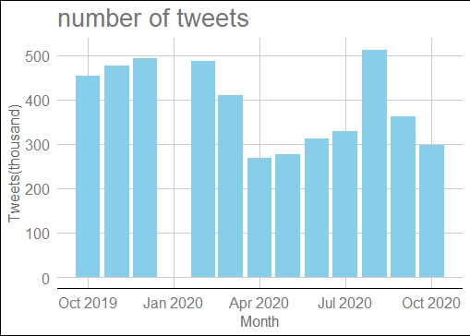

1. Intro – Data set
Period
Oct 2019 ~ Oct 2020 (19~20 season)
Due to Covid-19, 19-20 season ended in oct 2020
(Original schedule was March 2020)
2020 Jan Data is missing.
2. How many tweets ?
4.6 M
389k per Month
Notes:
I analyzed 12 month data from Oct 2019 to Oct 2020 except Jan 2020. The reason I used a year dataset is the 19-20 season ended in Oct 2020 due to Covid-19.
The number of tweets for this analysis is 4.6M.

Slide 5
1. Intro – Data set
Covid-19
19-20 Season had halted from 13th Mar to 30th Jul.
The last Final game was on 11th Oct
2.The Last Dance
The series released by ESPN in US, and serviced it by Netflix globally at the same time
It released Apr.20 – May20.
3.US President Election
Nov. 3 was the US president election
People can vote earlier by postal service depending on State law
Notes:
To understand the analysis more accurately, we need to remind ourselves of what was happened in 2020.
(Click) First of all, the season had halted from March 13th to July 30th, and the last of the Final game was on October 11th. (Click)
(Click) Secondly, documentary series about Michel Jordan named ‘The last dance’ was released from April to May. (Click)
Lastly, the US President election was on November 3rd, and people could vote earlier than the day by using the postal service.

Slide 6
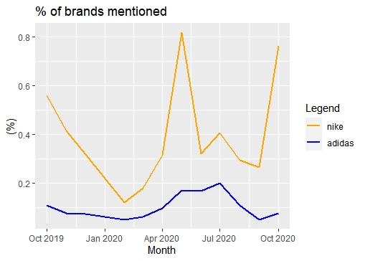
2. Analysis – Competitor
Tweets brands mentioned are less than 1%.
Comparing with Adidas, Nike mentioned 4 times more.
Nike : 0.4% , Adidas 0.1%
The highest rate is 0.8% and it seems the effect of The Last Dance
Notes:
I checked how often Nike and Adidas are mentioned on Twitter, but both are not significant.
They are less than 1%, but Nike was 4 times often than Adidas.
The highest rate was 0.8% in May. It seems to be an effect of The last dance.

Slide 7
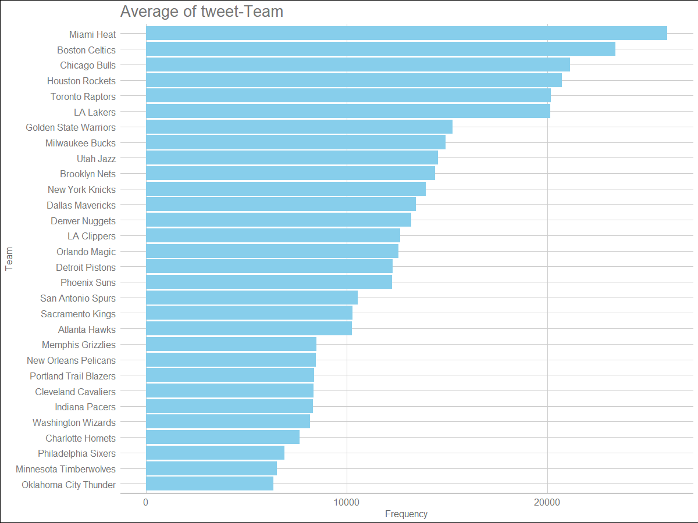
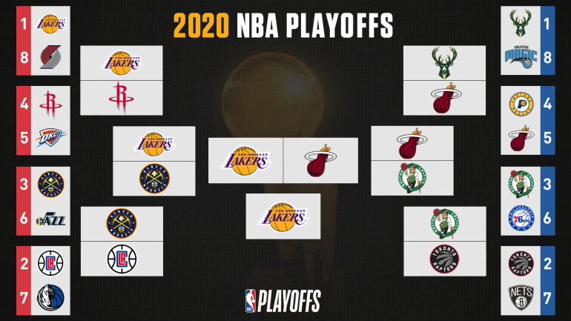
2. Analysis – Team
Teams can be divided into 3 groups
Average > 20k
Average < 10k
Middle group
The ranking tends to be determined by Playoff result.
CBSsports.com
Notes:
This page shows us how often each team is mentioned on Twitter. We can divide the teams into three groups.
(Click) The first group has an average of more than 20,000 tweets per month. Only five teams are including this group. Except for Chicago Bulls, they had playoff games, and each team had a superstar such as Jimmy butter, Harden, and Lebron James.
I think the reason Chicago bulls could be a top group even they were not good at this season is The Last Dance. (Click)
(Click) The bottom group is the average tweets number is below 10,000. Ten teams are in the group, and most of them are based on smaller cities than the other team. (Click)
(Click) The middle range group’s tweets are between 10,000 and 20,000. (Click)
The ranking is basically influenced by the team's performance. (Click) Miami Heat and LA Lakers have a final series, and they are in the top group. (Click) And Boston, which had conference final series, is also located in a high position. Denver is middle class even they also had conference final games. It shows us the limit of a small market team. (Click) The teams that went to the semi- conference final series are highlighted with a blue box. Houston and Toronto are the top group, and Milwaukee and LA Clippers are in the middle group. (Click) The yellow box shows which team went to the playoff and 4 teams are middle, and the others are a bottom group. Some bottom teams can go to the playoff because the NBA playoff system allows over 50% of teams to go to the post-season.
The other interesting point is from Chicago Bulls and Golden state Worriers. The two teams show how important the star is to make an issue. Although they cannot go to the playoff, the teams have a high ranking because of Michel Jordan and Stephen Curry.

Slide 8
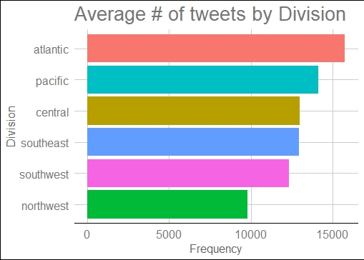
2. Analysis – Division
Atlantic Division is the most frequently mentioned Division.
Northwest is the least mentioned.
The other divisions do not have a big difference.
They mentioned between from 15k to 10k.
Notes:
The chart shows us the sum of the number of tweets by division. Atlantic division is mentioned frequently, and then Pacific division. Northwest division was the least division.

Slide 9
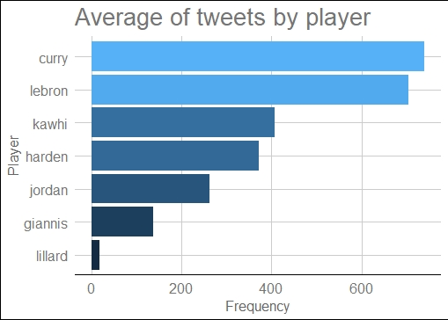
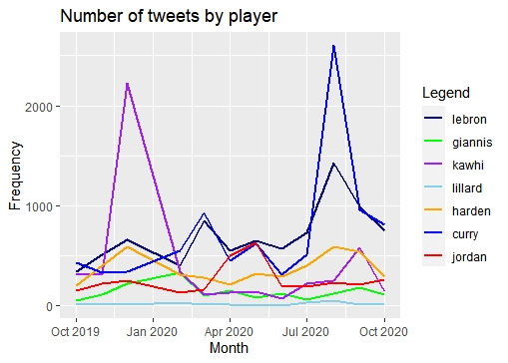
2. Analysis – Player
Curry and Lebron are the players most mentioned.
Overall, Lebron was mentioned as more stable.
Jordan also mentioned continuously.
An issue like a trade or an injury increase frequency sharply.
Curry injured 19-20 season
Kawai traded 19-20 season, and this is the first that the Final MVP changed a team
Notes:
Stephen Curry and Lebron James are the most popular player on Twitter. Their average number is over 600 per month. And the other players cannot over 500 times. Michel Jordan has mentioned around 300 per month even he is not a current player. An issue like trade or injury is influenced by the number of tweets. Kawhi had a trade, and Curry had injured during the early 19-20 season, so his come back and his condition was an issue for basketball fans.

Slide 10
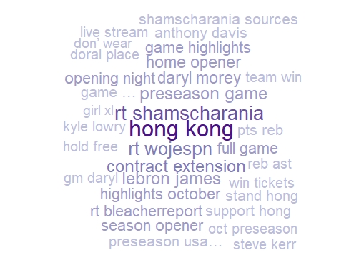
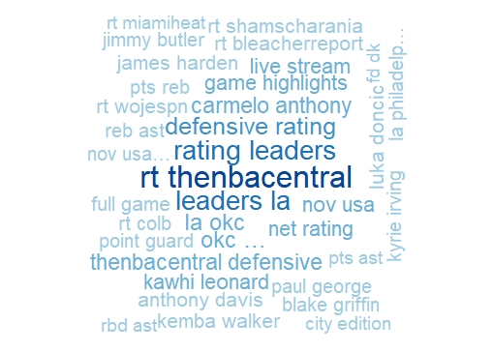
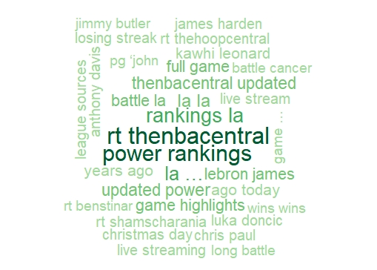
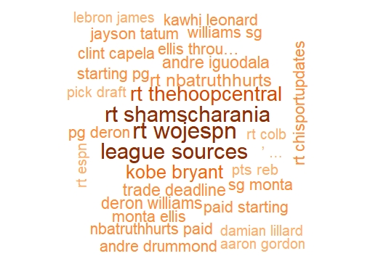
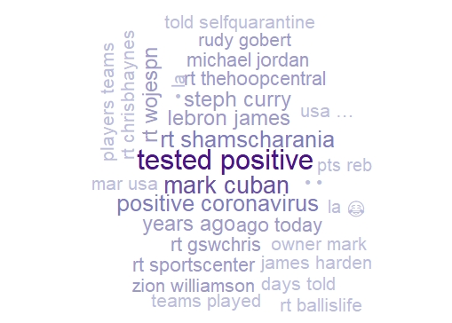
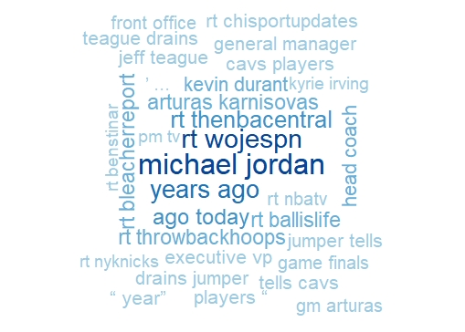
2. Analysis – Key words
Oct 2019
Nov 2019
Dec 2019
Feb 2020
Mar 2020
Apr 2020
Notes:
This page consists of monthly keywords analysis.
To do this analysis, I excluded the team name, and I chose a 1% sample data because the original data was too huge.
Hongkong in Oct 2019, tested positive in March 2020, and Michael Jordan in April 2020 told us what the issue was.
The interesting point of the keywords is many tweets mentioned full game, highlight, and live streaming. I checked these keywords with red boxes.

Slide 11
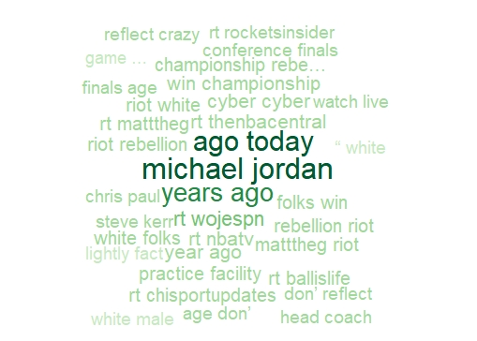
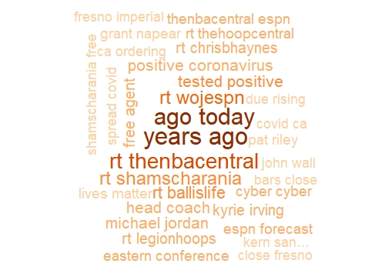
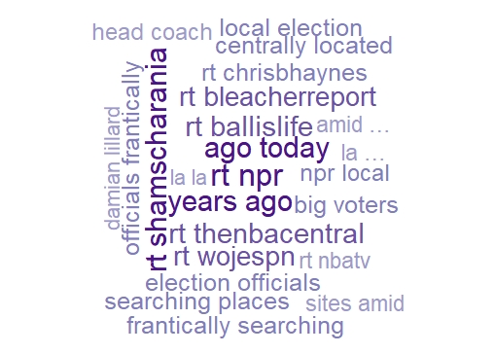
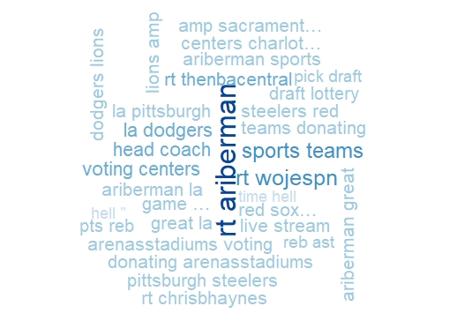
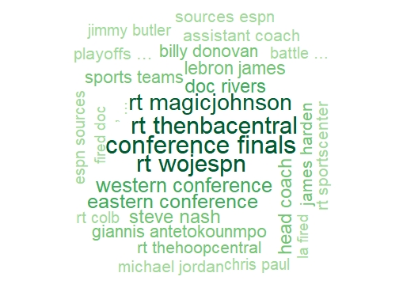
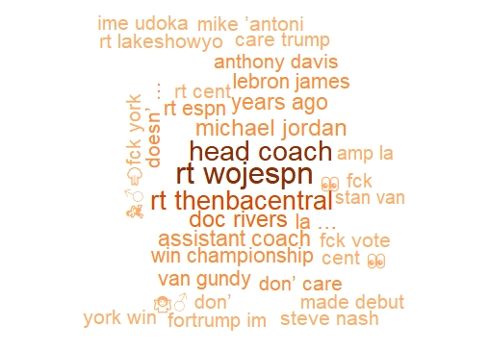
2. Analysis – Key words
May 2020
Jun 2020
Jul 2020
Aug 2020
Sep 2020
Oct 2020
Notes:
Next six months analysis also show voting, conference, and Jordan.

Slide 12
3. Conclusion
Assumption
More tweets mean more issues, and it makes an opportunity for marketing success.
Conclusion
Sponsoring a team that is likely to go to the playoff can be the most efficient way. But small-market teams are not good options even if they will go to a playoff.
Star player also has a big impact on Twitter. Stephen Curry and Michael Jordan are mentioned continuously, and they make their team also popular on Twitter even though the team did not go to a playoff.
Demand for Internet viewings such as live streaming and highlights seems to be increasing, and advertising methods need to be diversified accordingly. Like Jordan, it is necessary to review changes in the composition of products according to the release of media content.
Notes:
Here is the conclusion page.
My assumption before making the conclusion is more tweets mean more issues, and it makes an opportunity for marketing success.
In conclusion, choosing and sponsoring the team that expects to go to the Final series could be the best way to mention it often. But when we contract with a small market team, we should forecast their impact is smaller than a big market team.
Also, a star player is a critical part of making an issue. Curry and Jordan’s case shows us how important the star is in sports.
Lastly, we should consider expanding our marketing tools with various media channels. A lot of basketball fans seem to use internet streaming services, and we show that media content can make interest. As a result, our marketing method should expand from traditional sports marketing to internet and media-friendly way.

Slide 13
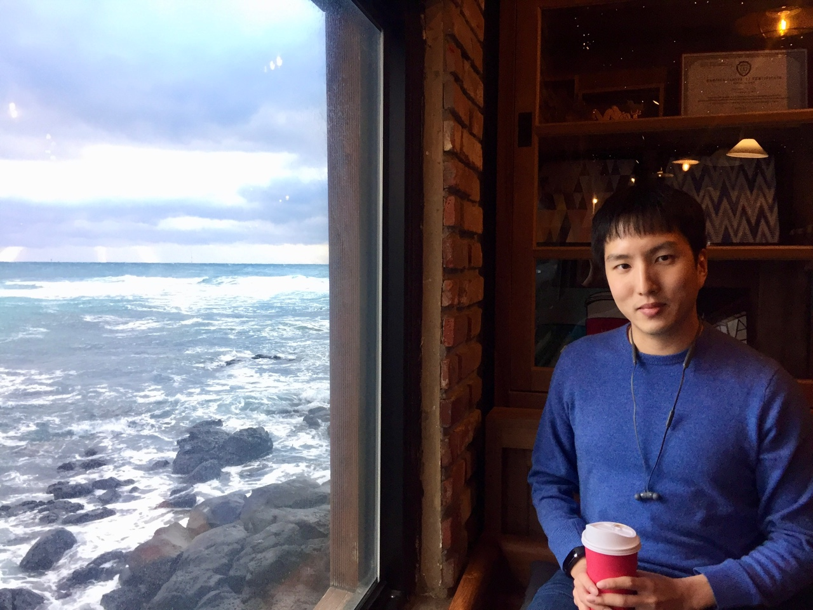
Contact
Jiho Song
Email : jsong2020@student.hult.edu
Linkedin : https://www.linkedin.com/in/jihosong2020/
Notes:
if you have any question and suggestions please contact me

Slide 14
End
Thank you !!
Notes:
Thank you for your listening and time.

